Slide 1
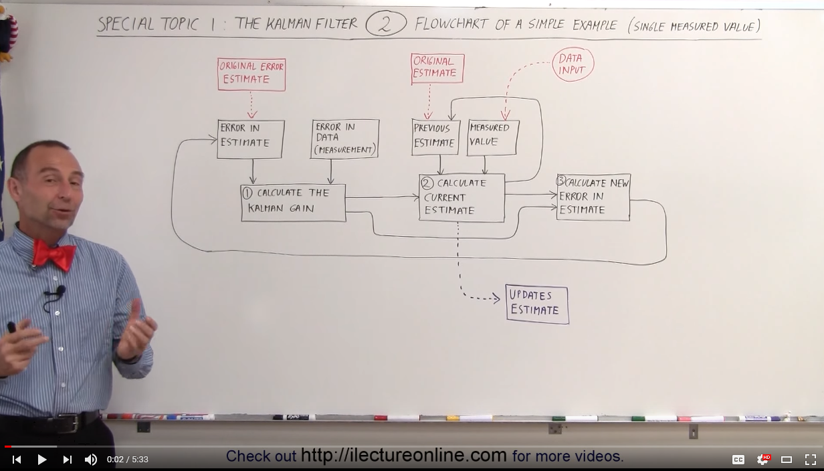
Kalman Filter on a single scalar value

Slide 2
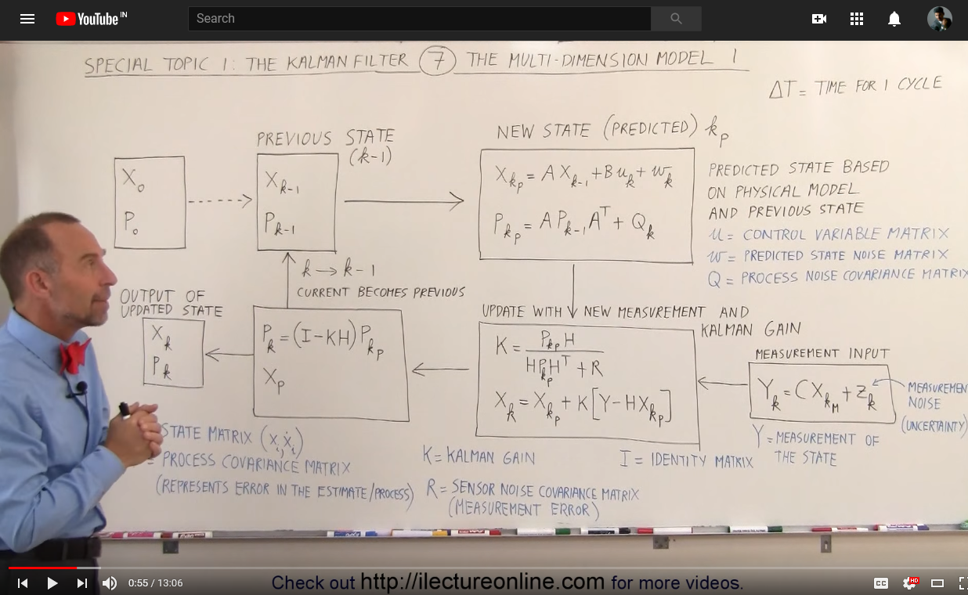
1 D kinematics – State Vector

Slide 3
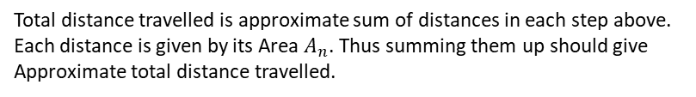
Constant Acceleration Model (derivation of its state transformation matrix)
Constant Velocity
Constant Acceleration
What is the distance travelled by the time tn?
Note from graph, area
Suppose our 2D space vector = {position, velocity}
Since constant velocity,..
Total distance travelled is approximate sum of distances in each step above.
Each distance is given by its Area $A_{n}$. Thus summing them up should give
Approximate total distance travelled.

Slide 4
Note, ours is a constant acceleration. Thus, equation of our line can be written as
Where m is just a slope
The more rectangles we take, the better the accuracy for area (i.e displacement)
Thus, when n tends to infinity, we get,
Note this is a Riemann sum which is equal to a definite integral
Thus we arrived at the area of triangle as total displacement.

Slide 5
Constant Acceleration after a while..
Now we know area of triangle could give us total displacement. Thus,
Acceleration ‘a’ is constant, so in relation with velocity,..
Again by same method, we could sum up individual indefinite rectangles
To get total displacement.
We already saw these
add up to
area of triangle
Suppose our 2D space vector = {position, velocity}

Slide 6
Suppose our 2D space vector = {position, velocity}
Suppose our 2D space vector = {position, velocity}
Trying to break it down systematically as shown, we get.,
In general,
And,
This is how we calculate 1D state estimates
Note: For brevity noise vector wt not considered for now.

Slide 7
1 D kinematics – Measurement Input

Slide 8
1 D kinematics – Covariance Matrix

Slide 9
1 D kinematics – Example
Given
Estimates
Observations
Observations
Step 1.1: First predicted state
Initial Conditions
Assumed Constant acceleration Model for state estimation
Displacement estimate and observations
not shown above as Its the area that would
be different between them
Pt because predicted state
But on RHS its estimated previous state

Slide 10
Step 1.2: Initial Covariance Matrix
Step 1.4: Calculating Kalman Gain
Step 1.3: Predicted Covariance Matrix

Slide 11
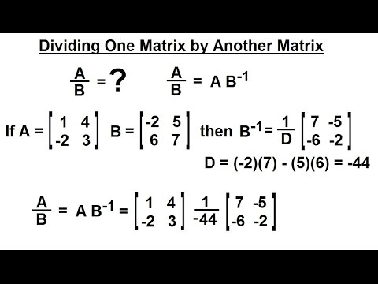
Step 1.5: Bringing in observation
Step 1.6: Estimated value

Slide 12
Step 1.7: Estimated Covariance Matrix
Summary of 1st cycle
Previous State & Error Estimate
Predicted State & Error
Measurement Noise
Measurement
New Error Estimate
Kalman Gain &
New State Estimate

Slide 13
Summary of 2nd cycle
Step 2.2: Predicted Covariance Matrix
Observations
Step 2.1: 2nd predicted state
Step 2.4: Bringing in observation
Step 2.3: Predicted Covariance Matrix

Slide 14
Step 2.5: New Estimated value
Step 2.6: Estimated Covariance Matrix

Slide 15
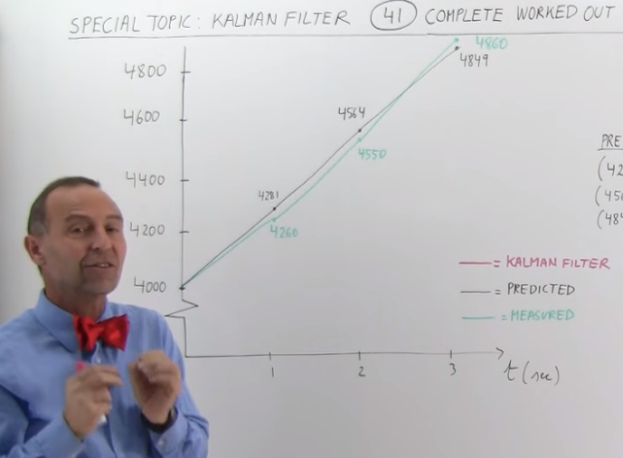
Summary of 3rd cycle
Step 3.2: Predicted Covariance Matrix
Observations
Michel Van Biezen stopped the cycle here
And explained the graph with values got so far.
Previous Estimations
Step 3.3: Kalman Gain
Step 3.1: 2nd predicted state

Slide 16
Michel Van Biezen’s notation
Udacity’s (almost same as wiki)
Predicted state estimate
Predicted estimate covariance
Kalman Gain
Measurement
Updated state estimate
Updated estimate Covariance

Slide 17
Previous state estimate and estimate covariance
Predicted state estimate and estimate covariance
Measurement Noise
Measurement
Updated estimate covariance
Kalman gain and updated state estimate

Slide 18
Previous
Predict
Measure
Update

